Slide 1
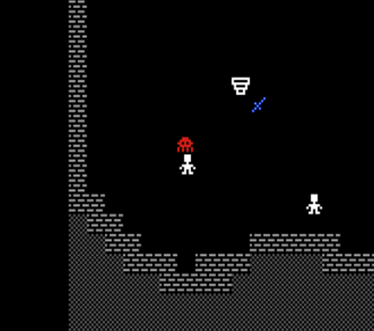

Multiplayer Roguelike for the Commodore 64
Leif Bloomquist
Roguelike Celebration
2019
@ GitHub HQ San Francisco USA
October 5-6 2019

Slide 2
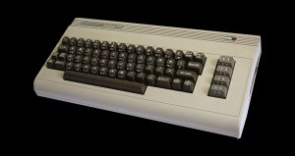
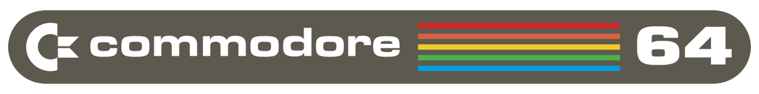
Why the Commodore 64?
I adore my Commodore 64!
Best-selling computer of all time! (Guinness Book of World Records: ~17 Million sold)
Released in 1982: 64KB RAM, 1 MHz CPU, 16 Colors, 3-Voice Sound
Over 25,000 games for the platform, including many Roguelikes
Fun to program on: Bare-metal, machine language, very well documented
Very active community in 2019: Gaming, collecting, developing, hardware hacking…
Photo Credits: VintageVibe, Wikipedia

Slide 3
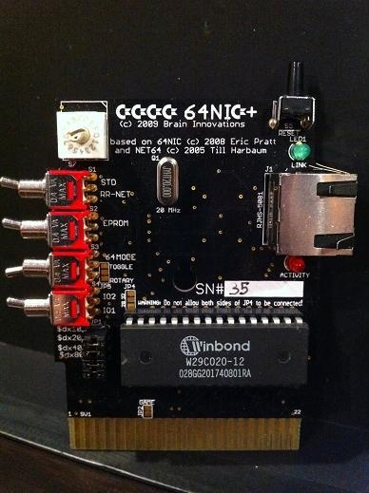
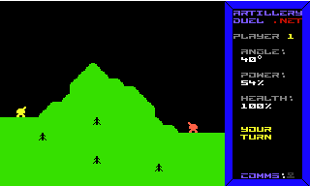
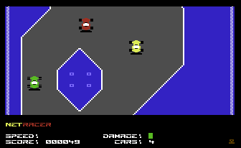
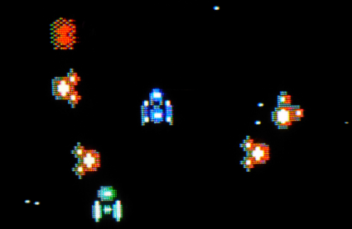
Multiplayer Games on the C64
There are numerous Ethernet and Wi-Fi solutions for the Commodore 64: RR-Net, ETH64, 64NIC+, etc.
Plenty of tools – file transfer, terminals, chat, cross-development, web browsers, etc.
How about some games!
Artillery Duel (2007)
NetRacer (2008)
Vortex (2014)
Photo Credit: CommodoreServer.com

Slide 4
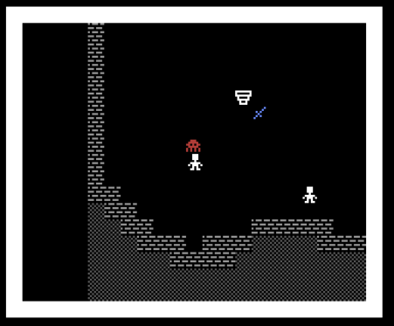
Next Challenge: A Roguelike
What if…the other characters in the dungeon were other players that you could…
Interact with?
Go on quests together with?
Team up with against monsters?
Work together with to solve puzzles?
Leave each other tools, clues, share equipment?
That would be cool!

Slide 5
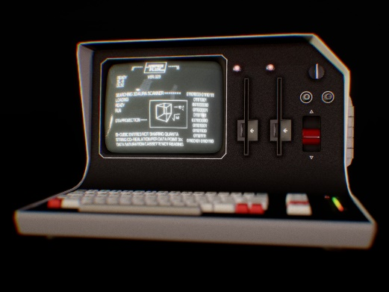
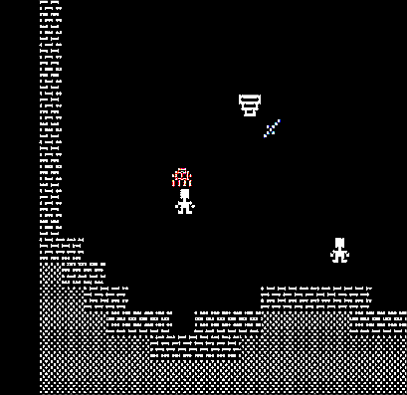
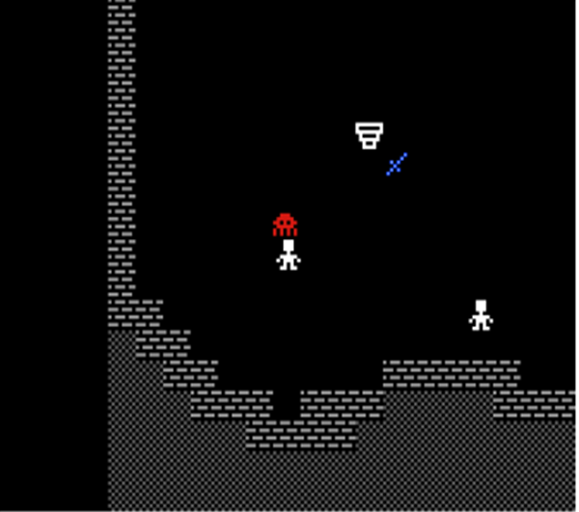
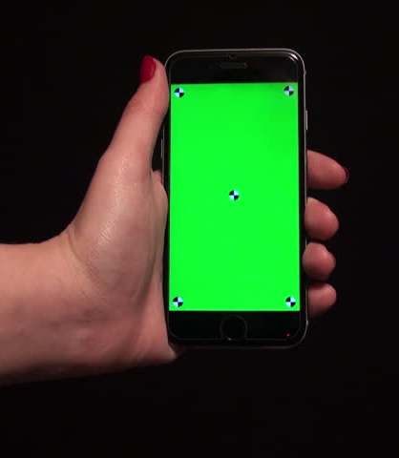

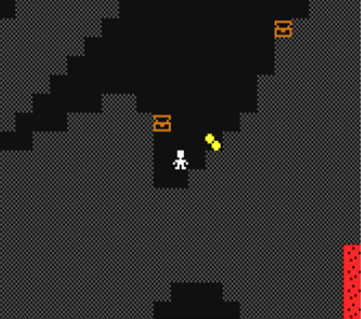
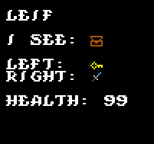
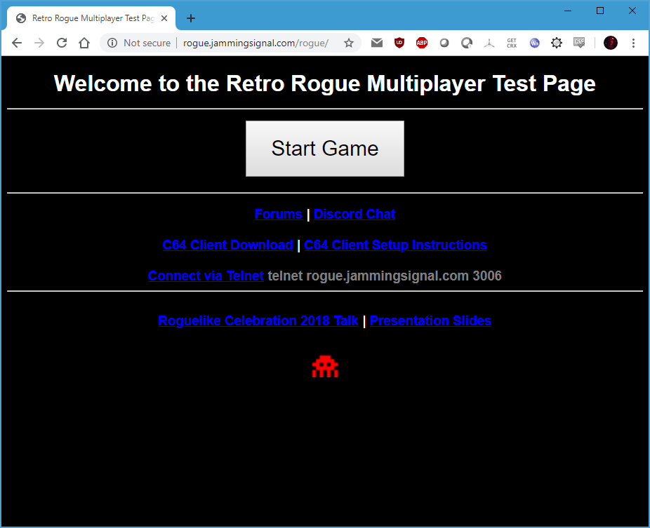
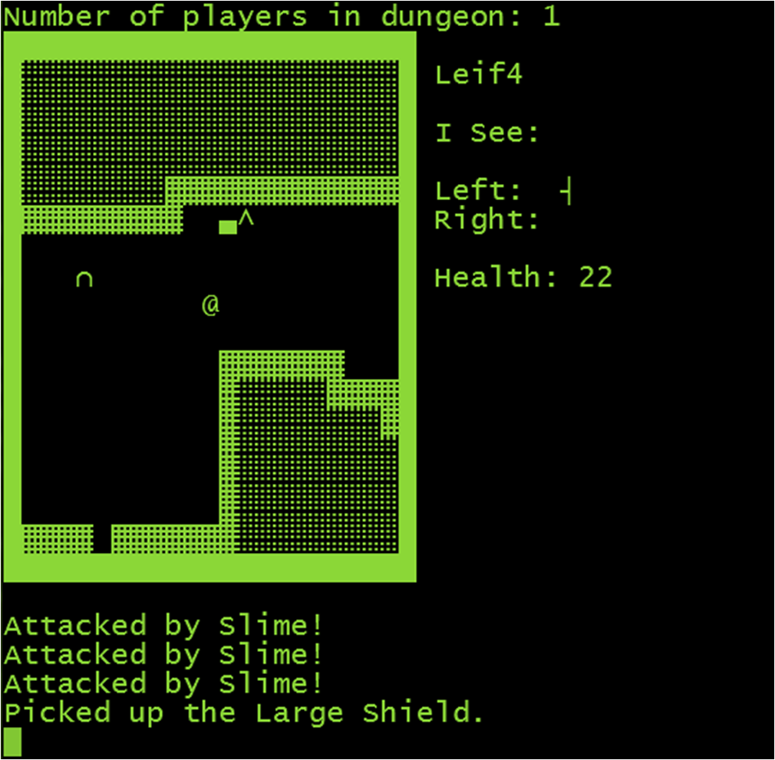
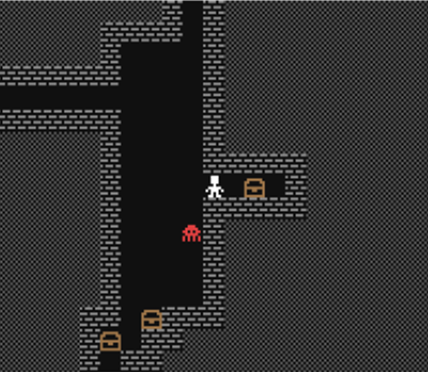
Many Platforms, All Playing Together!
Other Retro Platforms
Commodore 64
Dungeon
Mobile
Telnet / VT100
Modern Web Browser

Slide 6
Unique? Gameplay Mechanics
Carry items in Left hand and/or Right hand
Double up swords or shields, or one of each
Other items to be carried: Potions, Keys, Gold, etc
No “inventory” (to encourage multiplayer)
Use or inspect items
Play with Joystick on C64!
Voice chat though Discord

Slide 7
What’s New?
Numerous “tweaks” to gameplay after feedback from Roguelike Celebration 2018 and World of Commodore 2018
Improved feedback on combat (hits/misses, damage)
New “magic” items
Items are immediately described when you walk over them
Numerous bugfixes
Mobile version (not perfect yet…)

Slide 8
// TODO
The game still needs a name!
Improved mobile version
More client types
Different character types
More monster types
Ranged weapons
A* search for monster movement
Vision algorithms/raytracing
Much larger dungeon – procedurally generated
Still many gameplay details to be worked out

Slide 9
Want to Help?
Puzzle designers
Monster behaviours
Coders
Login system
Pixel artists
Level designers
Playtesters
Other clients
Gameplay
Balancing
…the game still needs a name!
Open Source – (MIT License)! On GitHub of course: ☺
https://github.com/LeifBloomquist/MultiRogueLike

Slide 10




Contact Info
www.jammingsignal.com (blog)
www.facebook.com/LeifBloomquist
@schemafactor
leif@schemafactor.com

Slide 11
Thank You!
C64 Networking code: Per Olofsson, Jonno Downes
Playtesting: Andreas Bloomquist and Mark Seelye
Graphics: “q0w/Atlantis”
Advice and motivation: Robin Harbron
/r/roguelikedev community on Reddit
The organizers of Roguelike Celebration!

Slide 12
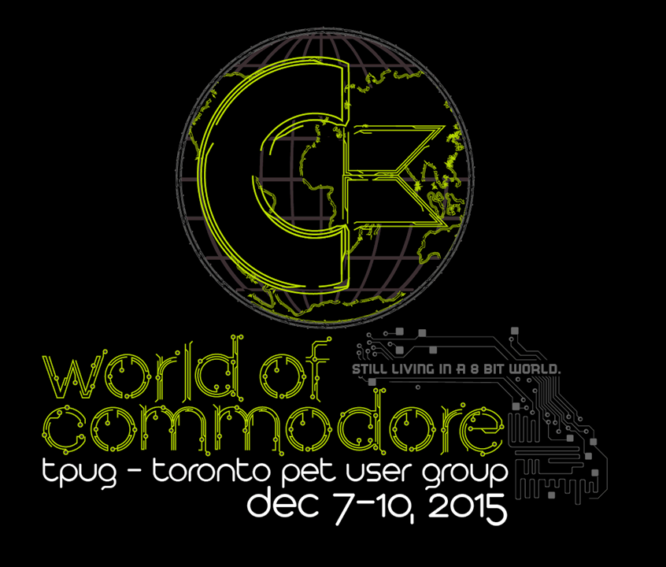
Toronto, Ontario Canada December 7, 2019
www.worldofcommodore.ca

Slide 13

Enough Talking, Let’s Play!
Web: http://rogue.jammingsignal.com/rogue/
Telnet: rogue.jammingsignal.com port 3006
C64: Client bootloader as PRG file (download from Web site)
The game is winnable: What is the magic word?

